Slide 1


YOUR QUALITY PARTNER FOR SOFTWARE SOLUTIONS
Robot framework
Web Automation - (Selenium for Desktop & Appium for Mobile)
Tho Pham
TMA Solutions
www.tmasolutions.com

Slide 2

Agenda
Duration: 6 hours with 2 parts
Prerequisites:
Have experiences on Robot Framework, Selenium
Download zip https://github.com/phamtantho/robotframework/tree/master/selenium_grid
On Windows: Put on C:/ and unzip
On Mac: Put on Desktop/ and unzip; go inside run cmd: chmod 755 *
Part 1 - Desktop:
Introduce Selenium Grid
Test web on windows (Chrome, Firefox, Edge)
Test web on MacOS (Chrome, Firefox, Safari)
Part 2 - Mobile:
Test web on Android (Chrome)
Test web on iOS (Safari)
Bonus: Headless browsers
Notes:
https://stackoverflow.com/questions/46812155/how-to-run-headless-remote-chrome-using-robot-framework
http://robotframework.org/SeleniumLibrary/SeleniumLibrary.html#Open%20Browser
https://github.com/mkorpela/pabot

Slide 3
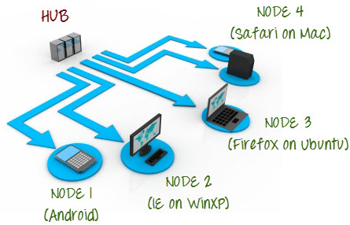
Selenium Grid
Introduction
Selenium-Grid allows you run your tests on different machines against different browsers and operating systems in parallel
More details: https://www.seleniumhq.org/docs/07_selenium_grid.jsp

Slide 4

Selenium Grid
Architecture
The Hub
The hub is the central point where you load your tests into.
There should only be one hub in a grid.
The hub is launched only on a single machine, i.g a computer whose O.S is Windows 10
The machine containing the hub is where the tests will be run, but you will see the browser being automated on the node.

Slide 5
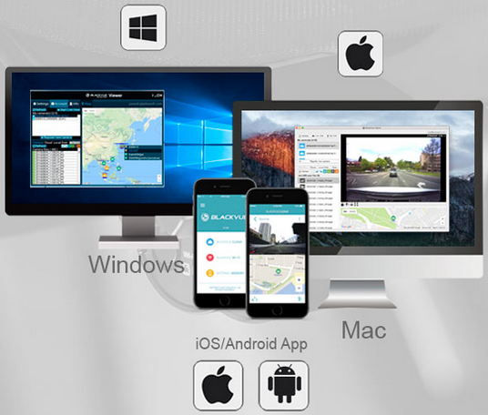
Selenium Grid
Architecture
The Nodes
Nodes are the Selenium instances that will execute the tests that you loaded on the hub.
There can be one or more nodes in a grid.
Nodes can be launched on multiple machines with different platforms and browsers.
The machines running the nodes need not be the same platform as that of the hub.

Slide 6
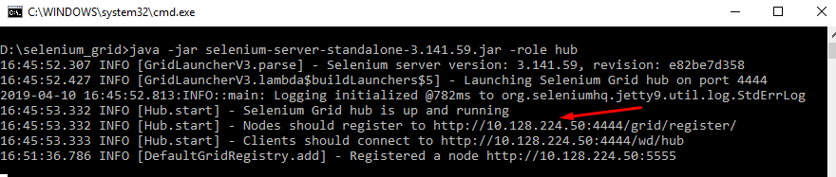
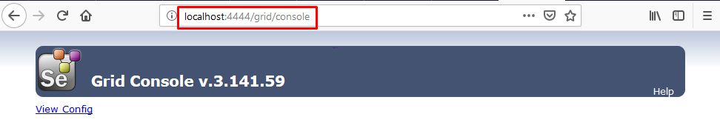
Selenium Grid
Start hub
Go to folder selenium_grid
On windows: double-click start_hub_on_windows.bat
On mac: open terminal, go to selenium_grid and run ./start_hub_on_mac.sh
Take note the hub’s IP. In this case 10.128.224.50
Verify hub status: Open page <localhost or hub’s IP>:4444/grid/console

Slide 7
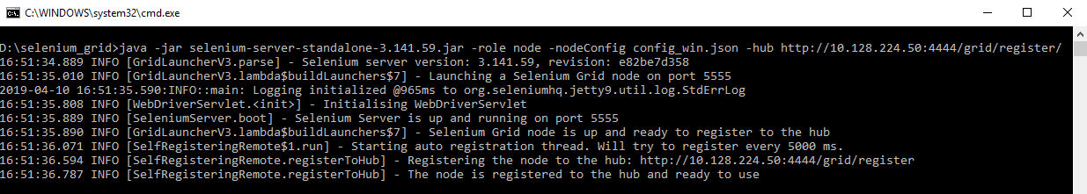
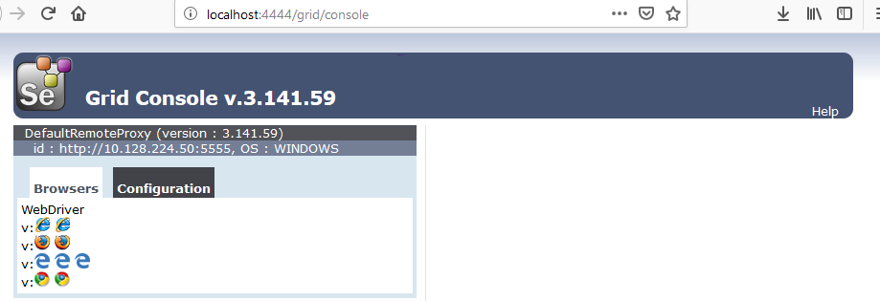
Test web on desktop
Start node on windows
Go to selenium_grid
Update hub’s IP in file config_win.bat
Line: "hub": "http://<hub’s IP>:4444",
Double click start_node_on_windows.bat
Notes:
Download latest IEDriver https://github.com/SeleniumHQ/selenium/issues/5738 https://github.com/SeleniumHQ/selenium/raw/master/cpp/prebuilt/x64/Release/IEDriverServer.exe

Slide 8
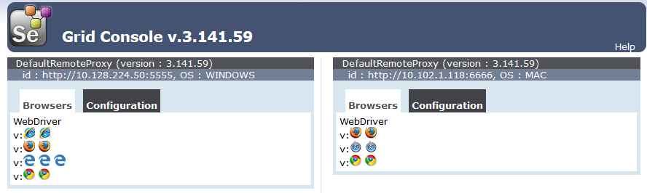
Test web on desktop
Start node on mac
Go to selenium_grid
Update hub’s IP in file start_node_on_mac.sh
Line: "hub": "http://<hub’s IP>:4444",
Run cmd ./start_node_on_mac.sh
Notes:
Should create .bat file to quick start hub and nodes

Slide 9
Sample test
Sample test 1
Go to Robot_web_testing > test_browsers
Take a look on this sample test
Execute and observe the results

Slide 10
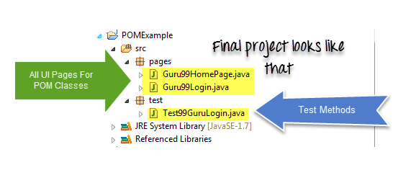
Page Object Model (POM)
What is POM
https://www.guru99.com/page-object-model-pom-page-factory-in-selenium-ultimate-guide.html
Notes:
https://developer.microsoft.com/en-us/microsoft-edge/tools/webdriver/
https://developer.microsoft.com/en-us/microsoft-edge/platform/issues/20144497/
Veerabhadra r. Jan 11, 2019 Microsoft Edge Team
Hi Thanks for reporting your feedback. The driver is now distributed as part of the OS, and
as such, should always be in sync with the browser. You will no longer need to
download a standalone executable, just make sure the feature of the OS is
installed
Settings - apps - manage optional
features - add a feature - Microsoft Webdriver

Slide 11
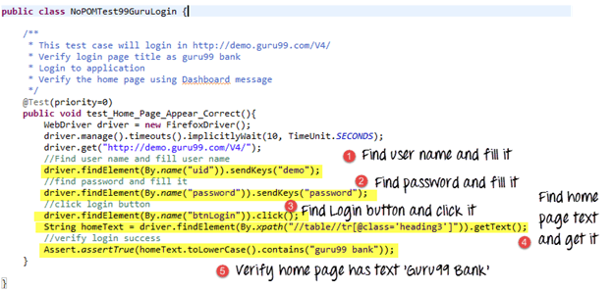
Page Object Model (POM)
Why Page Object Model?
Notes:
https://developer.microsoft.com/en-us/microsoft-edge/tools/webdriver/
https://developer.microsoft.com/en-us/microsoft-edge/platform/issues/20144497/
Veerabhadra r. Jan 11, 2019 Microsoft Edge Team
Hi Thanks for reporting your feedback. The driver is now distributed as part of the OS, and
as such, should always be in sync with the browser. You will no longer need to
download a standalone executable, just make sure the feature of the OS is
installed
Settings - apps - manage optional
features - add a feature - Microsoft Webdriver

Slide 12
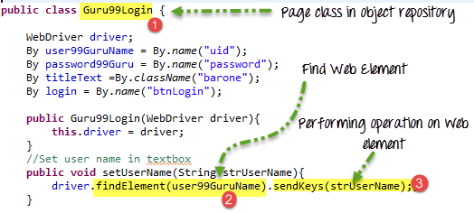
Page Object Model (POM)
Advantages of POM
Notes:
https://developer.microsoft.com/en-us/microsoft-edge/tools/webdriver/
https://developer.microsoft.com/en-us/microsoft-edge/platform/issues/20144497/
Veerabhadra r. Jan 11, 2019 Microsoft Edge Team
Hi Thanks for reporting your feedback. The driver is now distributed as part of the OS, and
as such, should always be in sync with the browser. You will no longer need to
download a standalone executable, just make sure the feature of the OS is
installed
Settings - apps - manage optional
features - add a feature - Microsoft Webdriver

Slide 13
Page Object Model (POM)
Sample test
Go to Robot_web_tesing > pom and sample_suite
Take a look on test scripts
Execute and observe results
Notes:
.json file:
{
"capabilities": [{
"browserName": "chrome",
"version": "6.0.1",
"maxInstances": 1,
"platform": "ANDROID",
"udid": "3204925330697185"
}
],
"configuration": {
"cleanUpCycle": 2000,
"timeout": 30000,
"proxy": "org.openqa.grid.selenium.proxy.DefaultRemoteProxy",
"url": "http://127.0.0.1:4729/wd/hub",
"maxSession": 1,
"port": "4729",
"host": "127.0.0.1",
"register": true,
"registerCycle": 5000,
"hubPort": "4444",
"hubHost": "127.0.0.1"
}
}
.bat file:
appium --address 127.0.0.1 --port 4729 -bp 8189 --nodeconfig node1.json --session-override &
More details:
http://appium.io/docs/en/advanced-concepts/grid/
https://github.com/SeleniumHQ/selenium/wiki/Grid2

Slide 14
Test web on mobile devices
Selenium Grid for Android devices
Next class…
Notes:
.json file:
{
"capabilities": [{
"browserName": "chrome",
"version": "6.0.1",
"maxInstances": 1,
"platform": "ANDROID",
"udid": "3204925330697185"
}
],
"configuration": {
"cleanUpCycle": 2000,
"timeout": 30000,
"proxy": "org.openqa.grid.selenium.proxy.DefaultRemoteProxy",
"url": "http://127.0.0.1:4729/wd/hub",
"maxSession": 1,
"port": "4729",
"host": "127.0.0.1",
"register": true,
"registerCycle": 5000,
"hubPort": "4444",
"hubHost": "127.0.0.1"
}
}
.bat file:
appium --address 127.0.0.1 --port 4729 -bp 8189 --nodeconfig node1.json --session-override &
More details:
http://appium.io/docs/en/advanced-concepts/grid/
https://github.com/SeleniumHQ/selenium/wiki/Grid2

Slide 15
Test web on mobile devices
Selenium Grid for Android devices
Enable Debug mode on Android device
Connect Android device to Windows machine
Click Allow on popup if appears
On Windows machine:
Download adb package
Add advanced system variable ANDROID_HOME=Android path (i.g D:\Robot\SDK)
Add Path for tools (%ANDROID_HOME%\tools) and platform-tools (%ANDROID_HOME%\platform-tools)
Test configuration: Open cmd, type command adb devices → Should show connected device. Otherwise, double check the configurations above.
Create .json file → node configurations
Create .bat file → shortcut to start the node
Notes:
.json file:
{
"capabilities": [{
"browserName": "chrome",
"version": "6.0.1",
"maxInstances": 1,
"platform": "ANDROID",
"udid": "3204925330697185"
}
],
"configuration": {
"cleanUpCycle": 2000,
"timeout": 30000,
"proxy": "org.openqa.grid.selenium.proxy.DefaultRemoteProxy",
"url": "http://127.0.0.1:4729/wd/hub",
"maxSession": 1,
"port": "4729",
"host": "127.0.0.1",
"register": true,
"registerCycle": 5000,
"hubPort": "4444",
"hubHost": "127.0.0.1"
}
}
.bat file:
appium --address 127.0.0.1 --port 4729 -bp 8189 --nodeconfig node1.json --session-override &
More details:
http://appium.io/docs/en/advanced-concepts/grid/
https://github.com/SeleniumHQ/selenium/wiki/Grid2

Slide 16
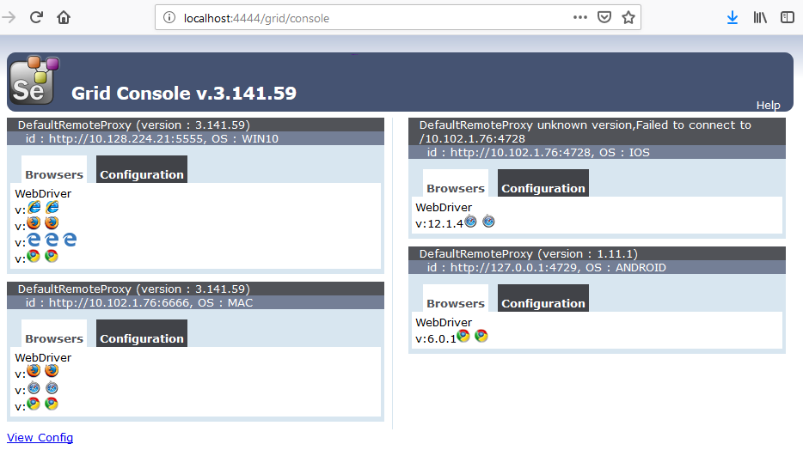
Remote driver
Selenium Grid for Desktop – Verify Grid
Open a browser and go to http://localhost:4444/grid/console
Notes:
{
"capabilities":
[
{
"browserName": "firefox",
"maxInstances": 2,
"seleniumProtocol": "WebDriver"
},
{
"browserName": "chrome",
"maxInstances": 2,
"seleniumProtocol": "WebDriver"
},
{
"browserName": "internet explorer",
"maxInstances": 2,
"seleniumProtocol": "WebDriver"
},
{
"browserName": "edge",
"maxInstances": 2,
"seleniumProtocol": "WebDriver"
}
],
"proxy": "org.openqa.grid.selenium.proxy.DefaultRemoteProxy",
"maxSession": 5,
"port": 5555,
"register": true,
"registerCycle": 5000,
"hub": "http://localhost:4444",
"nodeStatusCheckTimeout": 5000,
"nodePolling": 5000,
"role": "node",
"unregisterIfStillDownAfter": 60000,
"downPollingLimit": 2,
"debug": false,
"servlets" : [],
"withoutServlets": [],
"custom": {}
}

Slide 17
Test web on mobile devices
Selenium Grid for iOS devices
Settings>Developer>Enable UI Automation
Connect iOS device to MacOS machine
Click Trust on popup if appears
On MacOS machine:
Upgrade to Xcode 10.1 ← MacOS 10.13.6
Install Appium GUI: https://github.com/appium/appium-desktop/releases/tag/v1.11.0
The XCUITest Driver for iOS: http://appium.io/docs/en/drivers/ios-xcuitest/index.html
XCUITest Driver Real Device Setup: http://appium.io/docs/en/drivers/ios-xcuitest-real-devices/
Create .json file → node configurations
Create .bat file → shortcut to start the node
Notes:
.json file:
{
"capabilities": [{
"browserName": "chrome",
"version": "6.0.1",
"maxInstances": 1,
"platform": "ANDROID",
"udid": "3204925330697185"
}
],
"configuration": {
"cleanUpCycle": 2000,
"timeout": 30000,
"proxy": "org.openqa.grid.selenium.proxy.DefaultRemoteProxy",
"url": "http://127.0.0.1:4729/wd/hub",
"maxSession": 1,
"port": "4729",
"host": "127.0.0.1",
"register": true,
"registerCycle": 5000,
"hubPort": "4444",
"hubHost": "127.0.0.1"
}
}
.bat file:
appium --address 127.0.0.1 --port 4729 -bp 8189 --nodeconfig node1.json --session-override &
More details:
http://appium.io/docs/en/advanced-concepts/grid/
https://github.com/SeleniumHQ/selenium/wiki/Grid2

Slide 18

Robot Framework
Q&A

Slide 19

THANK YOU !
Tel:
Mobile:
Fax:
Email:
+84 8 3997-8000
+84 908-676-212
+84 8 3990-3303
sales@tmasolutions.com
North America number:
Australia number:
Japan number:
Website:
+ 1 802-735-1392
+ 61 414-734-277
+81 3-6432-4994
www.tmasolutions.com

